Slide 1
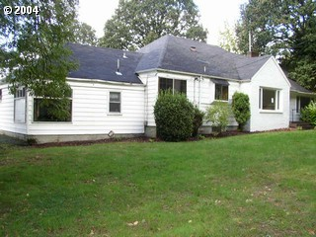
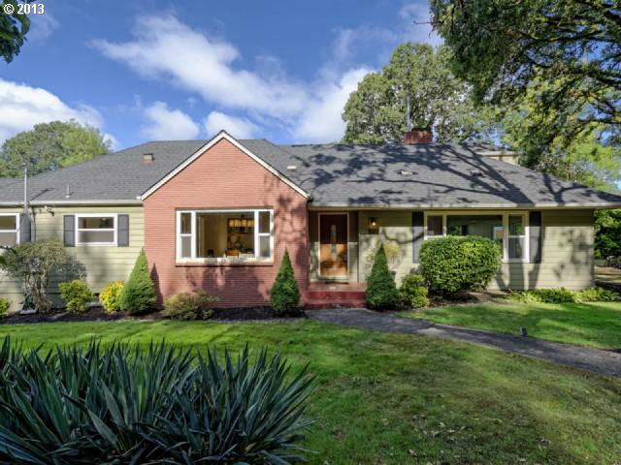




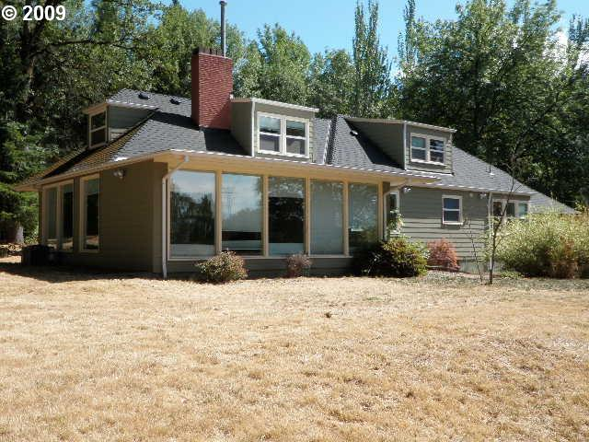
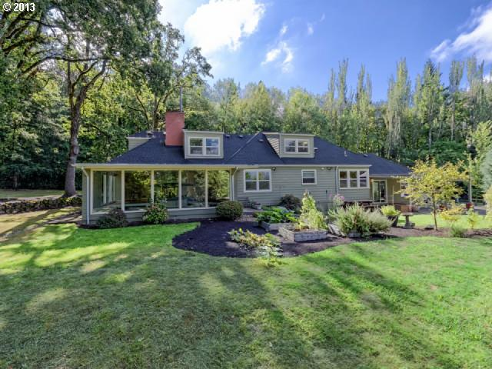
Private Lender Program Overview

Slide 2
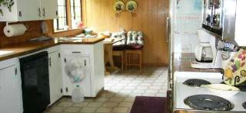
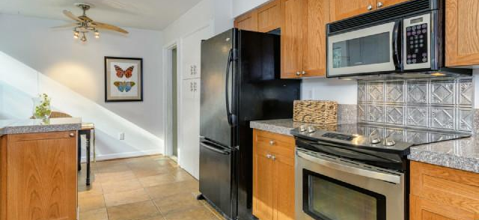
Why Invest With Us

Slide 3
We Offer
We have the experience, integrity and can provide safe returns secured by real estate. We offer:
Superior returns
Secured by real estate
Proven track record of completed projects
Proven methodology for locating and acquiring discounted real estate
Proven methods for rehabbing and selling
Established credibility and proven support team
Versus:
Passbook Savings: <1%
Certificate of Deposit (CDs): 1-3%
30 Year Treasury Bills: +/-3%
Stocks: ???

Slide 4
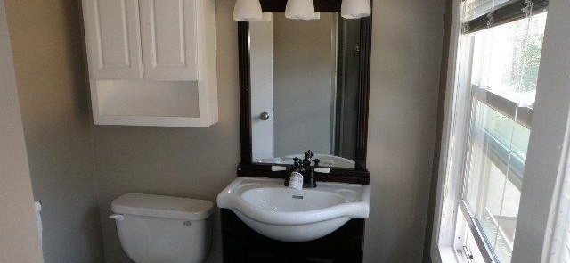
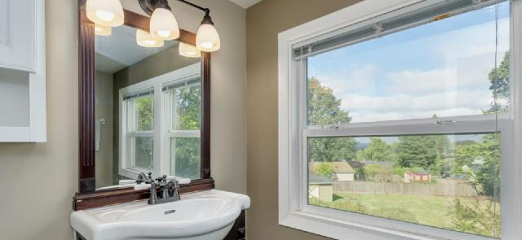
Methodology
We look for undervalued or value-add properties where we can buy, fix up and sell, with a target return of at least 15% Return on Investment (ROI).

Slide 5
Target Markets
Primary target markets will be the general Portland Area, to include the Oregon Coast and Central Oregon.
Price Points
Primary price ranges for target properties will be from $50,000-
$500,000, but will not exclude opportunities below or above this range-as long as the profit potential is there.

Slide 6
Interest Rates
Interest rates will be negotiated, with the base rate at 10% per year, simple interest. Rates for amounts <$100,000, will be slightly less and rates for >$100,000 will be slightly more. All rates will be agreed upon in writing and included in the loan documents.
Loan
Loan will be from accredited investors. The loan will be simple interest, with all interest paid at the end of the loan. Arrangements can be made if the lender wants monthly or quarterly payments.
Term of the loan
Unless otherwise stipulated, the term of the loan will be one year, with two six months options. These basic terms do not cover the possibility of a multi-year loan so the funds lent can grow, unencumbered by time constraints.

Slide 7
Location of Rehab Candidate
Up to this date, primary means of locating rehab candidates has been through relationships with Realtors. To scale this business, new techniques will be used. Some of these techniques will be direct mail to Probate, Divorce and Absentee Landlord Properties. Other techniques will use mediums such as Craigslist, Zillow, Redfin, etc, in order to contact motivated owners/sellers. Pro forma calculations will be conducted using current comparable properties which are in need of repairs and fixed up, in order to determine the Maximum Allowable Offer.
Rehab Process
Once the property is purchased, care will be taken to analyze both the property and surrounding neighborhood in order to maximize, but not over- improve, the property. Rossman and Githens have been doing this for the last 25 years and are well versed in the most cost efficient procurement of vendors and materials.

Slide 8
Resale Process
In the past, the primary method of sales is to give the listing to the Realtor which brought the deal. As the business is scaled, other methods will be incorporated. Some of these methods will include selling FSBO, Craigslist, Zillow, Facebook and other advertising mediums.
Plan B (If the property does not sell in a reasonable amount of time)
Having lived through the Mortgage Meltdown of 2008, it pays to have a strategy in case of unforeseen obstacles. If a property has not sold within 6 months, both the borrower and lender will agree to rent the property. Once renter is in place, interest rate reverts to 7%, with lender receiving all cash flows, with investor making up any difference, if needed, between cash flows and interest payment. Investor manages the property. Lender funds any repairs, to be paid out of proceeds at the end of the deal. When property is sold, lender to receive an additional 15% of net profits.

Slide 9
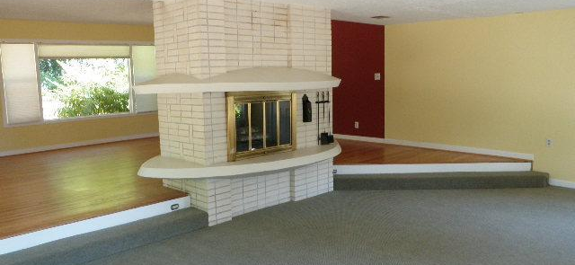
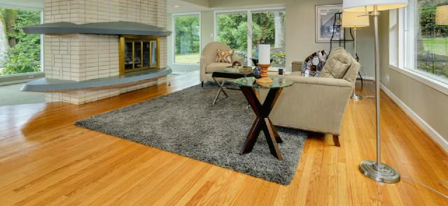
How Your Investment Is Secured

Slide 10
Whether it’s buying or selling, we always close with an accredited title company and provide the following documentation:
Promissory note which states the exact terms of our agreement and insures you receive the return agreed upon.
Security Deed/Trust Deed (Mortgage) which will put the property as collateral for your loan. That means we cannot sell the property or transfer title without paying you off. However, we may encumber the title if the need arises. An example would be to permit a vendor to put a lien on the title to ensure payment of services.
Lender’s Title Insurance will protect you against any current or future title problems.
Fire/Hazard Insurance will protect your investment in case of catastrophe.
The title company will take care of all of the documents and insure the mortgage is recorded against the property. You will receive the original signed note and copies of the mortgage, title insurance policy and hazard insurance. The Trust Deed is recorded and acts as a mortgage/lien against the property. If you have any questions, don’t hesitate to call our escrow officer or your attorney.

Slide 11
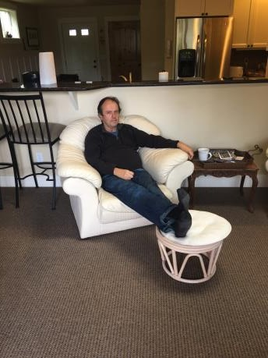
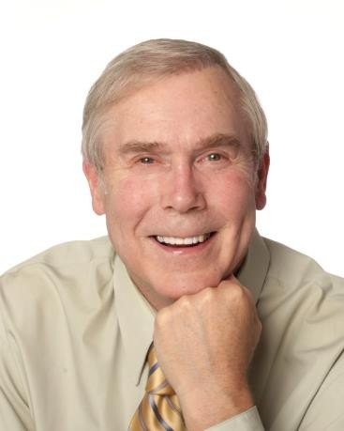
William P. Rossman
Our Team:
Kelly D. Githens
Born in the tough streets of Chicago, Bill learned the various facets of the rehab trade at an early age. As a young man, Bill spearheaded the migration of his family to the Pacific Northwest in the early 1980’s.His diverse set of talents led him to procuring his Screen Actors Guild (SAG) Card as well as building and selling two separate business. In the early 1990’s he turned his talents into the rehab field and to this date has completed well over 50 separate profitable projects. Among the many talents in his skill set, he has become proficient in the art of dealing, coordinating and scheduling primary and subcontractors. Unscathed by the Mortgage Meltdown and in concert with his own projects, he has worked extensively with developers and builders and become proficient at locating and analyzing potential development, underutilized or value-add real estate projects. Applying his tradecraft, Bill has several new construction projects completed and is poised to continue his success.
Raised in Portland, Oregon, he graduated from Oregon State University in 1976 and enlisted in the Army, where he served over nine years, resigning as a Captain in 1985. He then worked as an expat in Saudi Arabia, where he first began his career in real estate in 1987 when, between contracts, he earned his Real Estate Sales License and bought his first investment property. Upon returning to the United States, he finished his Masters Degree in Business and acquired his Appraisal Certification. While learning how to perform comprehensive due diligence and appraise various types of real estate, he also rehabbed, built and developed, specializing in “Shoebox” Condominiums. During the course of his endeavors, he authored two eBooks titled “Looking at Real Estate Through the Eyes of an Appraiser” and “How to Value Real Estate in Distant Markets”. He is currently raising private money to leverage real estate deals.

Slide 12
Recently Completed Projects

Slide 13
Let’s discuss the available opportunities!
kellygithens@gmail.com (503) 502-7867

